Slide 1
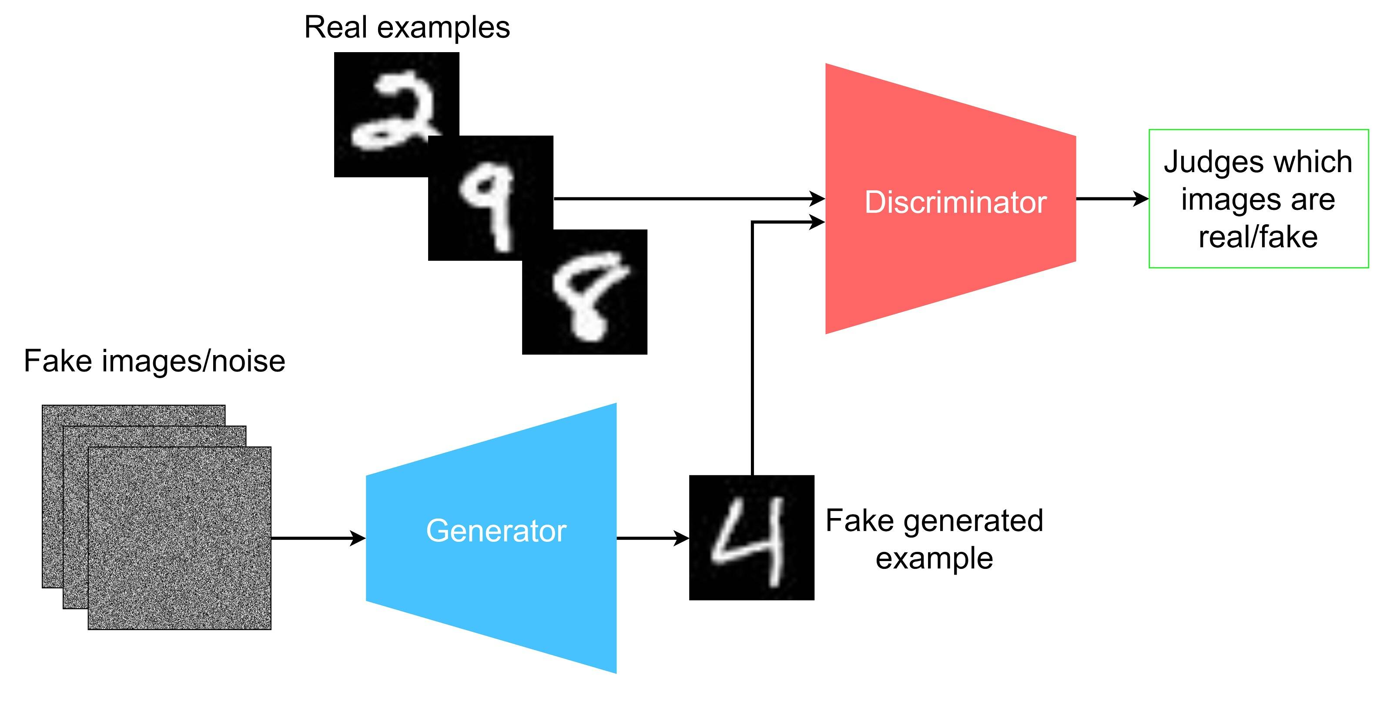
NAME : M.JANAKI
NM ID : au412721205019
PROJECT TITLE :GENERATION OF IMAGES USING GAN
COLLEGE:TAGORE ENGINEERING COLLEGE

Slide 2
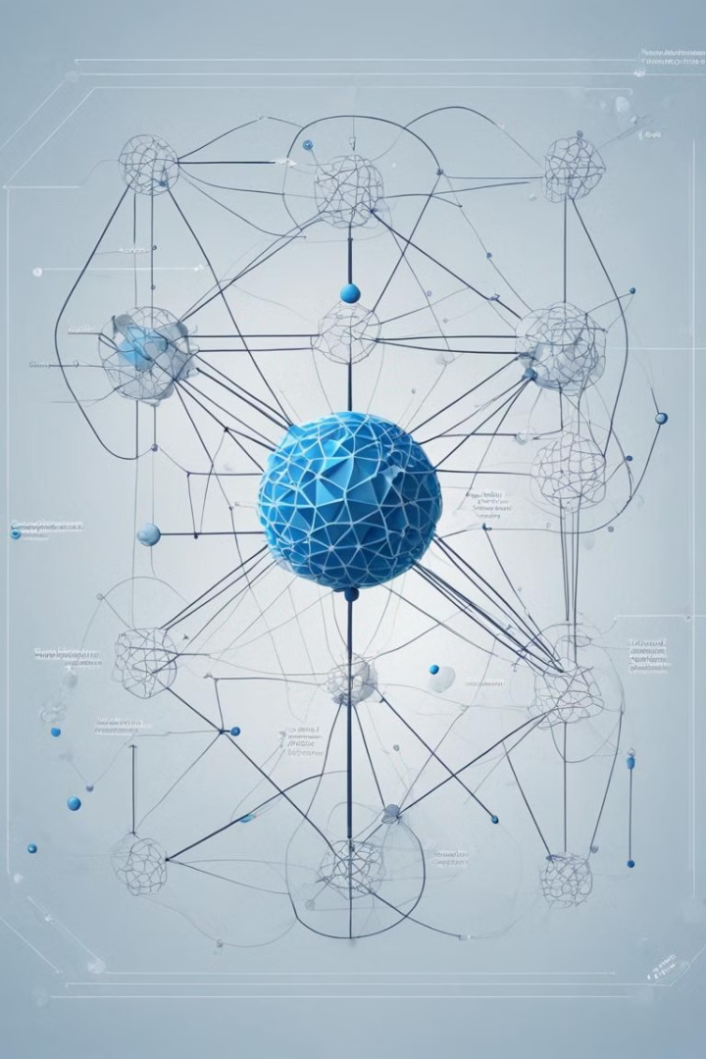
Introduction to Generative Adversarial Networks (GANs)
Generative Adversarial Networks (GANs) are a powerful class of machine learning models that can generate new, realistic-looking data. GANs pit two neural networks against each other - a generator and a discriminator - in a game-like training process to produce highly convince .
Notes:
2

Slide 3

Agenda
1
Problem Statement
Defining the key challenge that GANs aim to solve.
2
Project Overview
Outlining the high-level approach and goals of the GAN project.
3
Modeling
Describing the architectural details and training process of the GAN model.
Notes:
3

Slide 4
Problem Statement
Generating Realistic Data
Unsupervised Learning
Wide Applicability
GANs can learn to generate new data without the need for labeled training samples, making them a powerful tool for unsupervised learning tasks.
GANs have been successfully applied to a variety of domains, including image generation, text synthesis, and even music composition.
Traditional machine learning models often struggle to generate highly realistic and diverse synthetic data. GANs aim to overcome this limitation.
Notes:
4

Slide 5

Project Overview
1
Objective
2
Approach
3
Evaluation
Develop a GAN model capable of generating high-quality, diverse synthetic images.
Train the GAN using a large dataset of real-world images, optimizing the model's architecture and hyperparameters.
Assess the generated images based on metrics like visual fidelity, diversity, and realism.
Notes:
5

Slide 6

Who are the end users?
Researchers
Businesses
Scientists and academics studying machine learning techniques, particularly in the field of generative models.
Companies in industries like gaming, advertising, and media that require high-quality synthetic data for various applications.
Developers
Software engineers and AI enthusiasts looking to leverage GAN technology for their own projects and applications.
Notes:
6

Slide 7
Your Solution and its Value Proposition
High-Quality Synthesis
Fast and Efficient
Versatile Applications
Our GAN model produces highly realistic and diverse synthetic images that are virtually indistinguishable from real-world data.
The model is optimized for speed and can generate new images quickly, making it suitable for real-time applications.
The generated images can be used in a wide range of applications, from data augmentation to content creation.
Notes:
7

Slide 8




The Wow in Your Solution
Innovative Architecture
Our GAN model incorporates cutting-edge architectural components and training techniques to push the boundaries of what's possible with generative models.
Unprecedented Realism
The generated images are virtually indistinguishable from real-world data, thanks to the model's ability to capture intricate details and complex patterns.
Diverse Output
Our GAN can generate a wide variety of unique and distinct images, avoiding the repetitive and monotonous outputs common in many generative models.
Notes:
8

Slide 9
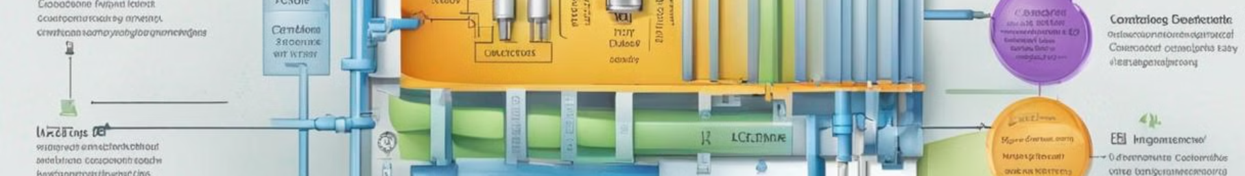
Modeling
Generator Network
1
The generator network is responsible for transforming random noise into synthetic images that resemble the training data.
2
Discriminator Network
The discriminator network is trained to distinguish between real and generated images, providing feedback to the generator.
Adversarial Training
3
The generator and discriminator networks are trained in an adversarial manner, with the generator trying to fool the discriminator and the discriminator trying to accurately classify the images.
Notes:
9

Slide 10
Results
Metric
Value
Image Quality (FID)
8.2
Diversity (IS)
4.7
Realism (AMT Turing Test)
82%
Notes:
10

